Slide 1
Graph Theory

Slide 2
Konigsberg bridge problem
The problem is stated as follows:
Starting from any of the four land areas A, B, C, D, is it possible to cross each of the seven bridges exactly once and come back to the starting point without swimming across the river?

Slide 3
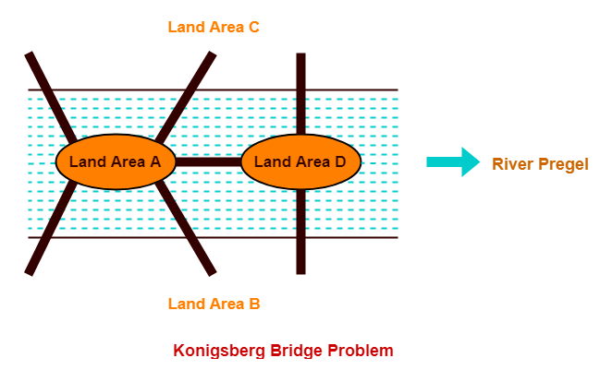
Introduction

Slide 4
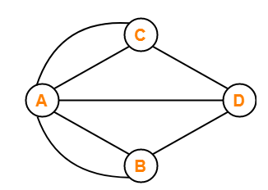
Solution?
In 1735, a Swiss Mathematician Leon hard Euler solved this problem.
He provided a solution to the problem and finally concluded that such a walk is not possible.
Euler represented the given situation using a graph as shown below

Slide 5
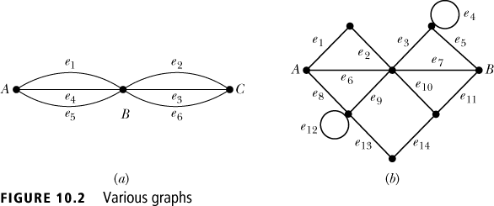
Graph Definitions and Notation
Consider the following problem related to an old children’s game. Using a pencil, can each of the diagrams in Figure 10.2 be traced, satisfying the following conditions?
The tracing must start at point A and come back to point A.
While tracing the figure, the pencil cannot be lifted from the figure.
A line cannot be traced twice.
As in geometry, each of points A, B, and C is called a vertex of the graph and the line joining two vertices is called an edge.

Slide 6
Definition
A graph G = (V ,E) consists of V , a nonempty set of vertices (or nodes) and E, a set of edges. Each edge has either one or two vertices associated with it, called its endpoints.
An edge is said to connect its endpoints.

Slide 7
Definition-Undirected graph
A graph G = (V, E) consists of V, a nonempty set of vertices, and E, a set of unordered pairs of distinct elements of V called edges.
For each e∈E, e = {u, v} where u, v ∈ V.
. An edge e is a loop if e = {u, u} for some u∈V.

Slide 8
Examples
How can we represent a network of (bi-directional) railways connecting a set of cities?
We should use a graph with an edge {a, b} indicating a direct train connection between cities a and b.

Slide 9
EXAMPLE
Bombay
Calcutta
Bangalore
Delhi
Chennai
Punjab

Slide 10
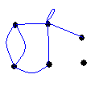
Undirected Graph - example

Slide 11
Multiple Edges- Multigraph

Slide 12
A simple graph - graph

Slide 13
Trivial Graph and Null Graph
A graph with one vertex and no edges is a trivial graph.
A graph with no edges is a null graph.

Slide 14
Adjacent Vertices (Neighbors)
Two vertices, u and v in an undirected graph G are called adjacent (or neighbors) in G, if {u, v} is an edge of G.
An edge e connecting u and v is called incident with vertices u and v, or is said to connect u and v. The vertices u and v are called endpoints of edge {u, v}.

Slide 15
Degree of a vertex
The degree of a vertex in an undirected graph is the number of edges incident with it, except that a loop at a vertex contributes twice to the degree of that vertex.
c
d
deg( d ) = 1
b
deg( b ) = 6
deg( g ) = 4
a
g
f
e
deg( e ) = 0

Slide 16
Basic definitions
A vertex of degree 0 is called isolated, since it is not adjacent to any vertex.
Note: A vertex with a loop at it has at least degree 2 and, by definition, is not isolated, even if it is not adjacent to any other vertex.
A vertex of degree 1 is called pendant. It is adjacent to exactly one other vertex.

Slide 17
Simple Graph
A graph in which each edge connects two different vertices and where no two edges connect the same pair of vertices is called a simple graph.

Slide 18
Multigraphs
Graphs that may have multiple edges connecting the same vertices are called multigraphs. When there are m different edges associated to the same unordered pair of vertices {u, v}, we also say that {u, v} is an edge of multiplicity m.
A graph with parallel edges and self loops is called Multigraph.

Slide 19
Directed graph
A directed graph (or digraph) (V ,E) consists of a nonempty set of vertices V and a set of directed edges (or arcs) E. Each directed edge is associated with an ordered pair of vertices.
The directed edge associated with the ordered pair (u, v) is said to start at u and end at v.

Slide 20
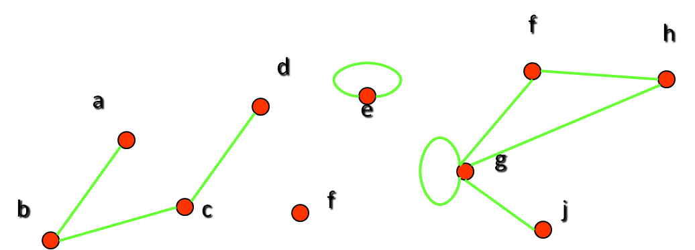
Examples
Which vertices in the following graph are isolated, which are pendant, and what is the maximum degree? What type of graph is it?

Slide 21
Examples
Let us look at the same graph again and determine the number of its edges and the sum of the degrees of all its vertices:
Result: There are 9 edges, and the sum of all degrees is 18. This is easy to explain: Each new edge increases the sum of degrees by exactly two.

Slide 22
Theorems
The Handshaking Theorem: Let G = (V, E) be an undirected graph with e edges. Then
2e = ∑_{v∈V} deg(v)
In the notation (p,q)-graph, p is its order and q its size.
That is, p is the number of vertices in G, and q is the number of edges in G.
Each edge is incident to exactly two vertices.
The degree of each vertex is defined as the number of edges to which it is incident.
So when we add up the degrees of all the vertices, we are counting all the edges of the graph twice

Slide 23
Example: How many edges are there in a graph with 10 vertices, each of degree 6?
Solution: The sum of the degrees of the vertices is 6⋅10 = 60. According to the Handshaking Theorem, it follows that 2e = 60, so there are 30 edges.

Slide 24
Theorems
Theorem: An undirected graph has an even number of vertices of odd degree.
Proof: Let V1 and V2 be the set of vertices of even and odd degrees, respectively (Thus V1 ∩ V2 = ∅ and V1 ∪V2 = V).
Then by Handshaking theorem
2|E| = ∑_{v∈V} deg(v) = ∑_{v∈V1} deg(v) + ∑_{v∈V2} deg(v)
Since both 2|E| and ∑_{v∈V1} deg(v) are even,
∑_{v∈V2} deg(v) must be even.
Since deg(v) if odd for all v∈V2, |V2| must be even.

Slide 25
Definition
Definition: In a graph with directed edges, the in-degree of a vertex v, denoted by deg⁻(v), is the number of edges with v as their terminal vertex.
The out-degree of v, denoted by deg⁺(v), is the number of edges with v as their initial vertex.
Question: How does adding a loop to a vertex change the in-degree and out-degree of that vertex?
Answer: It increases both the in-degree and the out-degree by one.

Slide 26
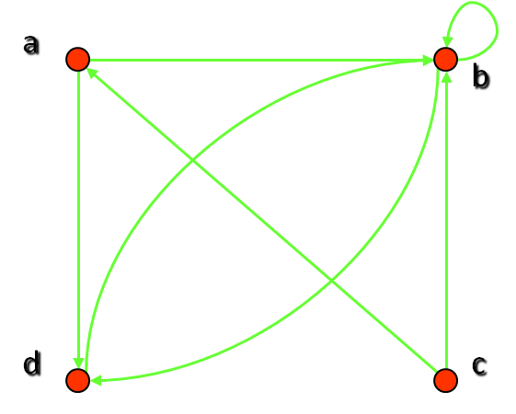
Examples
What are the in-degrees and out-degrees of the vertices a, b, c, d in this graph:
deg⁻(b) = 4
deg⁺(b) = 2
deg⁻(a) = 1
deg⁺(a) = 2

Slide 27
Theorem
Theorem: Let G = (V, E) be a graph with directed edges. Then:
∑_{v∈V} deg⁻(v) = ∑_{v∈V} deg⁺(v) = |E|
This is easy to see, because every new edge increases both the sum of in-degrees and the sum of out-degrees by one.

Slide 28
EXAMPLE
In this example
∑_{v∈V} deg⁻(v)= 7
∑_{v∈V} deg⁺(v)= 7
The number of edges is 7
Hence theorem holds.

Slide 29
Definition
A subgraph of a graph G = (V, E) is a graph H = (W, F) where W⊆V and F⊆E.
Note: Of course, H is a valid graph, so we cannot remove any endpoints of remaining edges when creating H.

Slide 30
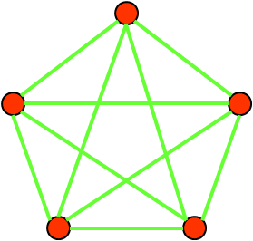
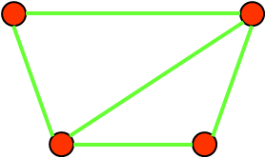
Example

Slide 31
Properties of Subgraph
Every graph is its own subgraph
A subgraph of H is a subgraph of G
A single vertex in a graph G is a subgraph of G
A single edge in G, together with its end vertices is a subgraph of G

Slide 32
Definition
Complement of a graph: A graph G’is said to be complement of a graph G if for every pair of vertices u,v is adjacent in G’, whenever it is not adjacent in G.

Slide 33
Matrix representation of graph
Definition: Let G = (V, E) be a simple graph with |V| = n. Suppose that the vertices of G are listed in arbitrary order as v₁, v₂, …, v_{n}.The adjacency matrix A (or A_{G}) of G, with respect to this listing of the vertices, is the n×n zero-one matrix with 1 as its (i, j)th entry when v_{i} and v_{j} are adjacent, and 0 otherwise.
In other words, for an adjacency matrix A = [a_{ij}],
a_{ij} = 1 if {v_{i}, v_{j}} is an edge of G, a_{ij} = 0 otherwise

Slide 34
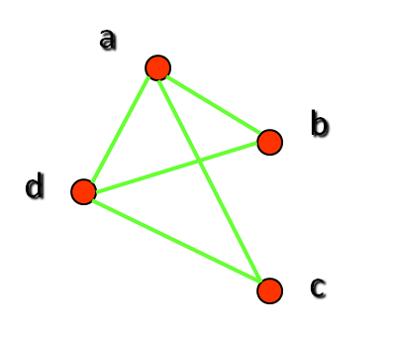
Example
What is the adjacency matrix A_{G} for the following graph G based on the order of vertices a, b, c, d ?
Note: Adjacency matrices of undirected graphs are always symmetric

Slide 35
Matrix representation of graph
Definition: Let G = (V, E) be an undirected graph with |V| = n. Suppose that the vertices and edges of G are listed in arbitrary order as v₁, v₂, …, v_{n} and e₁, e₂, …, e_{m}, respectively. The incidence matrix of G with respect to this listing of the vertices and edges is the n×m zero-one matrix with 1 as its (i, j)th entry when edge e_{j} is incident with v_{i}, and 0 otherwise.
In other words, for an incidence matrix M = [m_{ij}],
m_{ij} = 1 if edge e_{j} is incident with v_{i} m_{ij} = 0 otherwise.

Slide 36
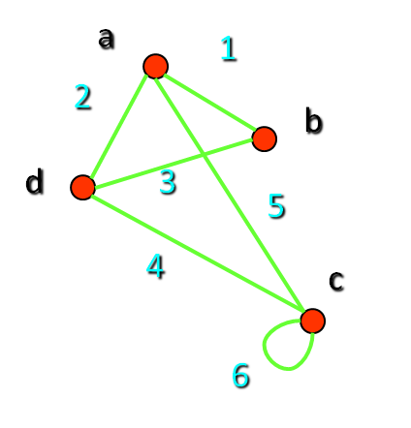
Example
What is the incidence matrix M for the following graph G based on the order of vertices a, b, c, d and edges 1, 2, 3, 4, 5, 6?
Note: Incidence matrices of directed graphs contain two 1s per column for edges connecting two vertices and one 1 per column for loops

Slide 37
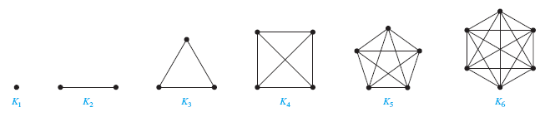

Slide 38
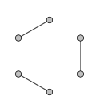
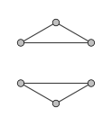
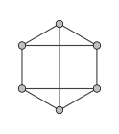
REGULAR GRAPH
Defn. A Regular graph is a graph which has the same number of neighbours (ie) every vertex has the same degree.
Below are the 1-regular,2-regular and 3-regular graphs.

Slide 39
Isomorphism of Graphs
Definition: The simple graphs G₁ = (V₁, E₁) and G₂ = (V₂, E₂) are isomorphic if there is a bijection (an one-to-one and onto function) f from V₁ to V₂ with the property that a and b are adjacent in G₁ if and only if f(a) and f(b) are adjacent in G₂, for all a and b in V₁.
Such a function f is called an isomorphism.
In other words, G₁ and G₂ are isomorphic if their vertices can be ordered in such a way that the adjacency matrices M_{G1} and M_{G2} are identical

Slide 40
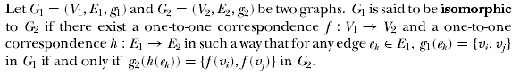
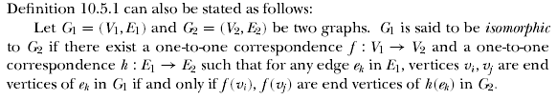
Isomorphism

Slide 41
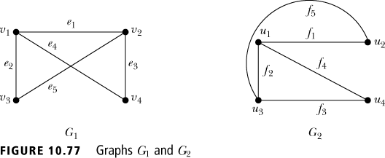
Isomorphism
In Figure 10.77, v1 and v2 are the end vertices of edge e1 in G1 and f(v1) = u1 and f(v2) = u3 are end vertices of edge h(e1) = f2 in G2. Also, f(v3) = u4 and f(v1) = u1 are the end vertices of edge f4 = h(e2) in G2 and v3 and v1 are end vertices of edge e2 in G1.
Similarly, for other vertices, any two vertices vi and vj are end vertices of some edge ek in G1 if and only if f(vi) and f(vj) are end vertices of edge h(ek) in G2.
G1 is therefore isomorphic to G2

Slide 42
Unfortunately, for two simple graphs, each with n vertices, there are n! possible isomorphisms that we have to check in order to show that these graphs are isomorphic.
From a visual standpoint, G₁ and G₂ are isomorphic if they can be arranged in such a way that their displays are identical (of course without changing adjacency).
However, showing that two graphs are not isomorphic can be easy.

Slide 43
For example, they must have
the same number of vertices,
the same number of edges, and
the same degrees of vertices.
For this purpose we can check invariants, that is, properties that two isomorphic simple graphs must both have.
Note that two graphs that differ in any of these invariants are not isomorphic, but two graphs that match in all of them are not necessarily isomorphic.

Slide 44
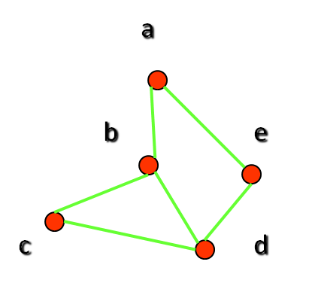
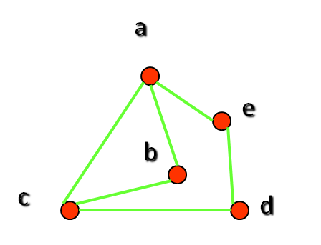
Example
: Are the following two graphs isomorphic?
Solution: Yes, they are isomorphic, because they can be arranged to look identical. You can see this if in the right graph you move vertex b to the left of the edge {a, c}. Then the isomorphism f from the left to the right graph is: f(a) = e, f(b) = a, f(c) = b, f(d) = c, f(e) = d.

Slide 45
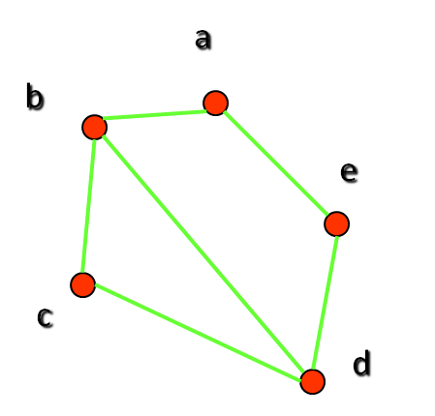
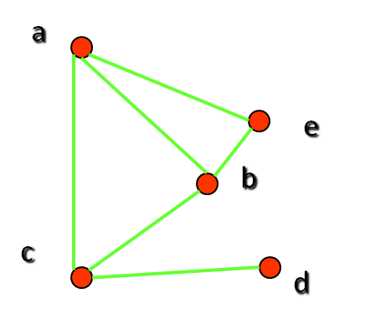
Example II: How about these two graphs?
Solution: No, they are not isomorphic, because they differ in the degrees of their vertices.
Vertex d in right graph is of degree one, but there is no such vertex in the left graph.

Slide 46
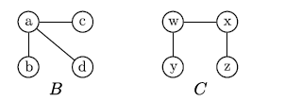
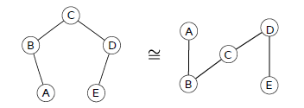
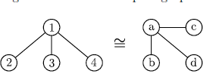
NON-ISOMORPHIC GRAPHS
ISOMORPHIC GRAPHS
V

Slide 47
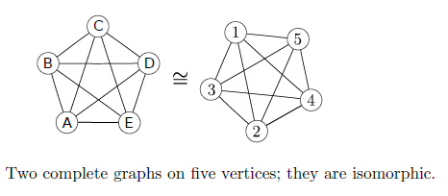

Slide 48
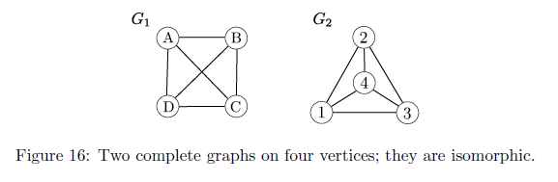

Slide 49
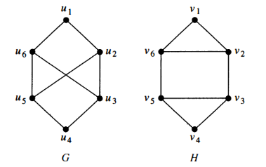
Determine whether the following are isomorphic
No G and H are not isomorphic

Slide 50
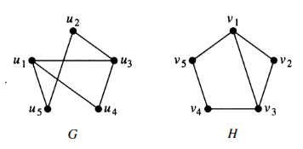
Find whether the following graphs are isomorphic
Yes they are isomorphic

Slide 51
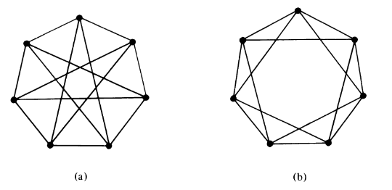
Check whether the following graphs are isomorphic
Yes they are isomorphic

Slide 52
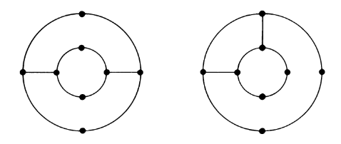
Check whether the following graphs are isomorphic

Slide 53
Definition
An undirected graph is called connected if there is a path between every pair of distinct vertices in the graph.
For example, any two computers in a network can communicate if and only if the graph of this network is connected.
Note: A graph consisting of only one vertex is always connected, because it does not contain any pair of distinct vertices.

Slide 54
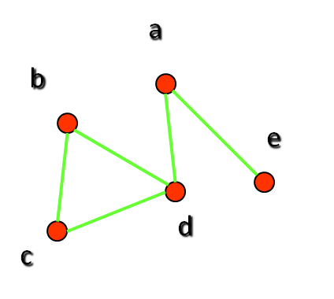
Example: Are the following graphs connected?

Slide 55
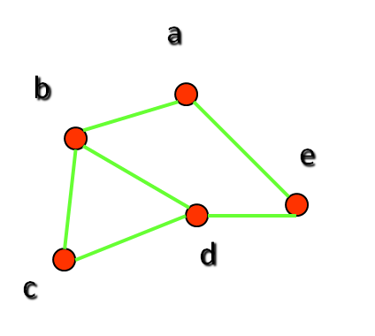
Examples

Slide 56
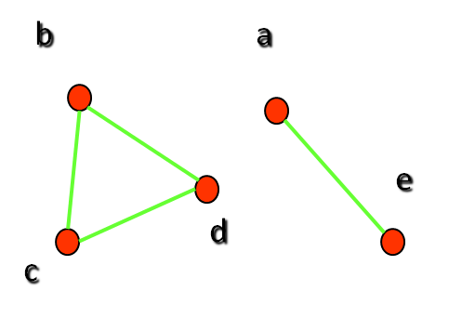
Examples

Slide 57
Definitions
An directed graph is strongly connected if there is a path from a to b and from b to a whenever a and b are vertices in the graph.
An directed graph is weakly connected if there is a path between any two vertices in the underlying undirected graph.

Slide 58

Example: Are the following directed graphs strongly or weakly connected?
Weakly connected, because, for example, there is no path from b to d.

Slide 59
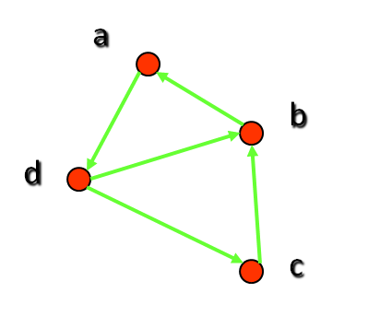
Examples
Strongly connected, because there are paths between all possible pairs of vertices.

Slide 60
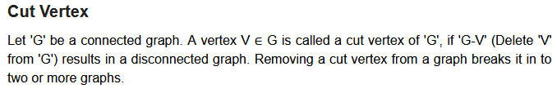

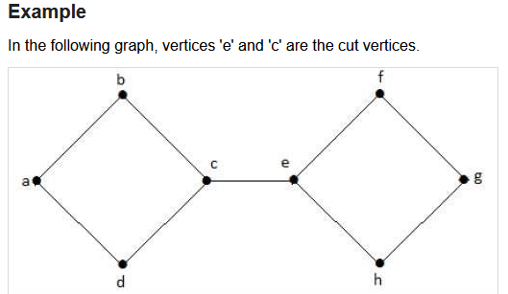

Slide 61
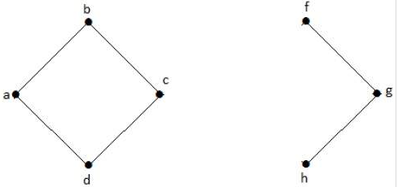

Slide 62
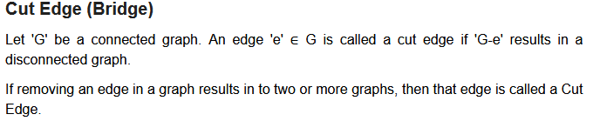
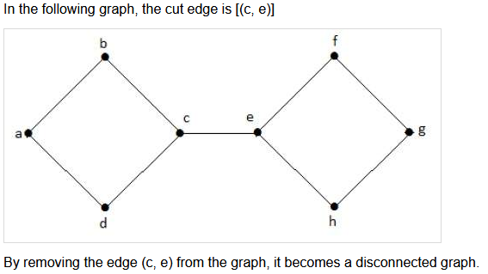

Slide 63
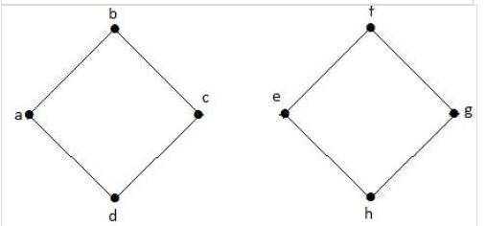
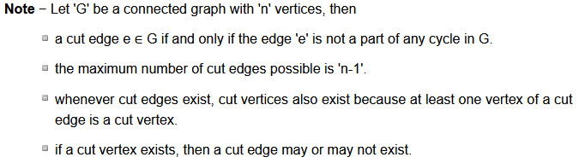

Slide 64
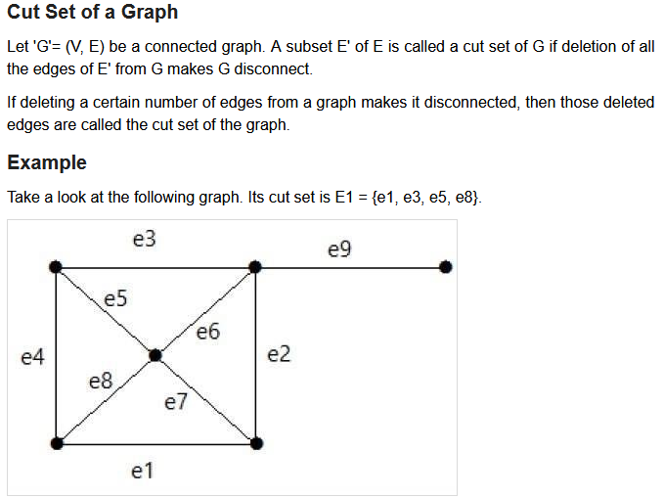

Slide 65
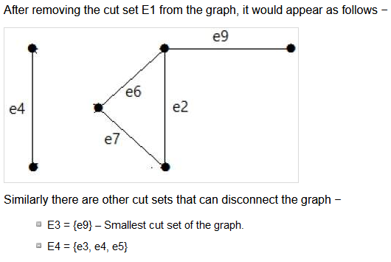

Slide 66
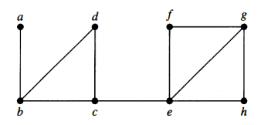
Find the cut vertices and cut edges in the following graph

Slide 67
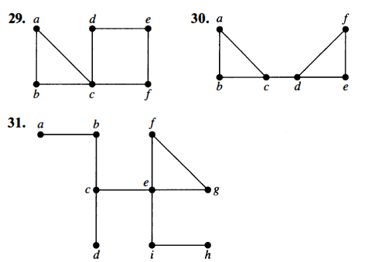
Find the cut vertices and cut edges in the following graphs

Slide 68
Check whether the following degree sequence is graphic
3,3,4,5,6
2,2,3,3

Slide 69
5,5,5,5,2,2,2
5,5,4,4,3,3,3

Slide 70
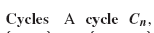
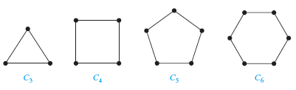

Slide 71


Slide 72
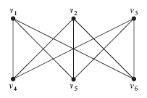
EXAMPLE

Slide 73
PLANAR GRAPHS
A PLANAR GRAPH IS AGRAPH THAT CAN BE DRAWN ON THE PLANE IN SUCH A WAY THAT ITS EDGES INTERSECT ONLY AT THEIR END POINTS (ie) NO EDGES CROSS EACH OTHER. SUCH A DRAWING IS CALLED A PLANE GRAPH OR PLANAR EMBEDDING OF THE GRAPH.
EXAMPLES:
BUTTERFLY GRAPH IS PLANAR
K5 IS NON PLANAR
K4 IS PLANAR

Slide 74
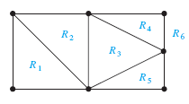

Slide 75
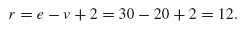

Slide 76
Definitions
A walk is an alternating sequence of vertices such that the adjacent pairs are edges
A trail is a walk with all edges distinct
A path is a walk with all vertices (and hence all edges) distinct
A closed walk is a walk that starts and ends at the same vertex
A circuit is a closed trail
A cycle is a closed path

Slide 77

Walks, Paths, and Cycles

Slide 78

Walks, Paths, and Cycles

Slide 79


Euler graph

Slide 81

Hamiltonian graph

Slide 82

Which of the following graphs have a Hamiltonian circuit or if not a Hamiltonian path?

Slide 83


A graph which is Hamiltonian and non–Eulerian
A graph which is Eulerian and non-Hamiltonian

Slide 84




Examples
Both Eulerian and Hamiltonian
Hamiltonian but not Eulerian
Eulerian but not Hamiltonian
Neither Eulerian nor Hamiltonian

Slide 86
Check whether the following graphs are Eulerian or Hamiltonian
1.
The graph is Eulerian but not Hamiltonian
2.
The graph is Hamiltonian but not Eulerian

Slide 87
3.
The above graph is neither Eulerian nor Hamiltonian

Slide 88

Travelling sales man problem

Slide 89




Slide 90

Ans
There are 8 paths between from a to d

Slide 91
Dijkstra’s algorithm/Greedy algorithm
This algorithm helps you to find the shortest path between nodes/vertices in a graph. This algorithm is used in GPS devices to find the shortest path between the current location and destination. It has broad applications in industry specially in domains that require modeling networks.
This algorithm was created and published by Dr.Edsger W. Dijkstra a Dutch computer scientist and software engineer.

Slide 92

Algorithm

Slide 93

Example

Slide 94







Step 1 Step 2 Step 3 Step 4 Step 5
Step 7 Step 8 Step 9

Slide 95




Step 9 Step 10
Step 11 Step 12

Slide 96


Step 13
Step 14

